Slide 1
Chapter 4
The Laws of Motion
The Second Law of Motion

Slide 2
The Second Law of Motion
According to Newton’s first law of motion, unbalanced forces cause the velocity of an object to change
Newton’s second law of motion describes how the net force on an object, its mass, and its acceleration are related

Slide 3
The Second Law of Motion
Force and Acceleration
Think about throwing a ball to a person standing in front of you some distance away
If you throw the ball hard vs throw it gently, what differs?
The net force (greater when you throw the ball hard)
The velocity (greater change in velocity as the hard thrown ball leaves your hand)
What’s the formula for acceleration again?
So which ball has the greater acceleration (the hard or gently thrown one)?
So to conclude, the greater the force, the greater the acceleration

Slide 4
The Second Law of Motion
Mass and Acceleration
AS THE MASS OF AN OBJECT IS INCREASED, THE ACCELERATION DECREASES

Slide 5
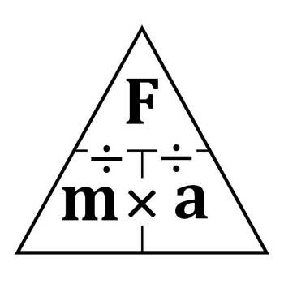
The Second Law of Motion
To put it all together…
The Second Law of Motion states that the acceleration of an object is in the same direction as the net force
You can calculate this using the formula
Acceleration = Net force (in Newtons)/Mass (in kg)
a=F/m
Units = m/s²
F= m x a
Units = N

Slide 6
The Second Law of Motion
Let’s practice!
If the mass of a helicopter is 4500 kg and the net force on it is 18000 N, what is the helicopter’s acceleration?
a = ?
F = 18000 N
m = 4500 kg
a = F/m = 18000 N/4500 kg = 4 m/s²
You push a friend on a sled. Your friend and the sled together have a mass of 70 kg. If the net force on the sled is 35 N, what is the sled’s acceleration?
a =
F =
m =

Slide 7
The Second Law of Motion
What is the net force on a dragster with a mass of 900 kg if its acceleration is 32 m/s²?
a =
F =
m =
A car is being pulled by a tow truck. What is the car’s mass if the net force on the car is 3000 N and it has an acceleration of 2 m/s²?
a =
F =
m =

Slide 8
Which would hurt more?...
(which applies more FORCE?)
An elephant (5000 kg) running into you at 2 m/s²
OR
A mouse (800 g = _________ kg) running into you at 50 m/s²
(use F=ma to solve!)

